Slide 1
Chapter 5 Input

Slide 2
Chapter 5 Objectives
Define input
Explain how a digital camera works
List the characteristics of a keyboard
Describe uses of Web cams and video conferencing
Describe different mouse types and how they work
Discuss various scanners and reading devices and how they work
Summarize how various pointing devices and controllers for gaming and media players work
Explain the types of terminals
Summarize the various biometric devices
Explain how voice recognition works
Identify alternative input devices for physically challenged users
Describe various input devices for smart phones, PDAs, and Tablet PCs
Next

Slide 3
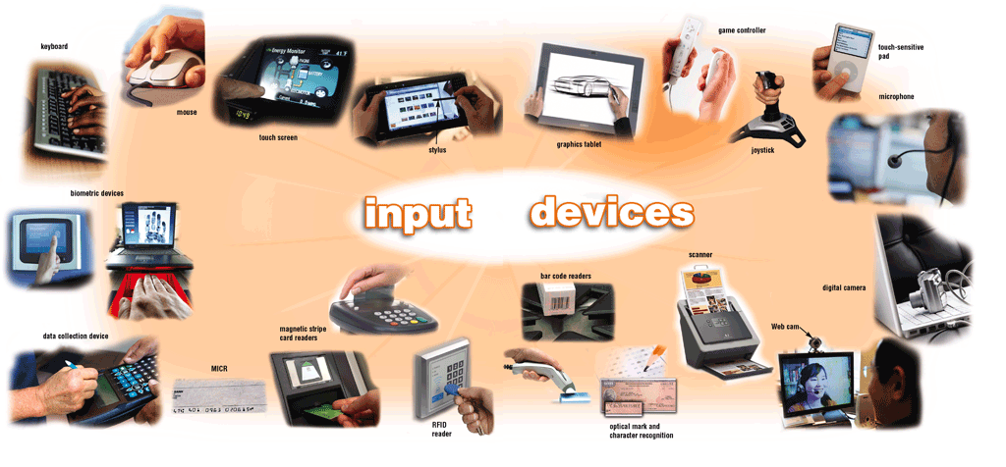
What Is Input?
What is input?
Data or instructions entered into memory of computer
Input device is any hardware component that allows users to enter data and instructions
p. 234 - 236 Fig. 5-1
Next

Slide 4
What Is Input?
What are the two types of input?
Data
Unprocessed text, numbers, images, audio, and video
Instructions
Programs
Commands
User responses
p. 234
Next

Slide 5
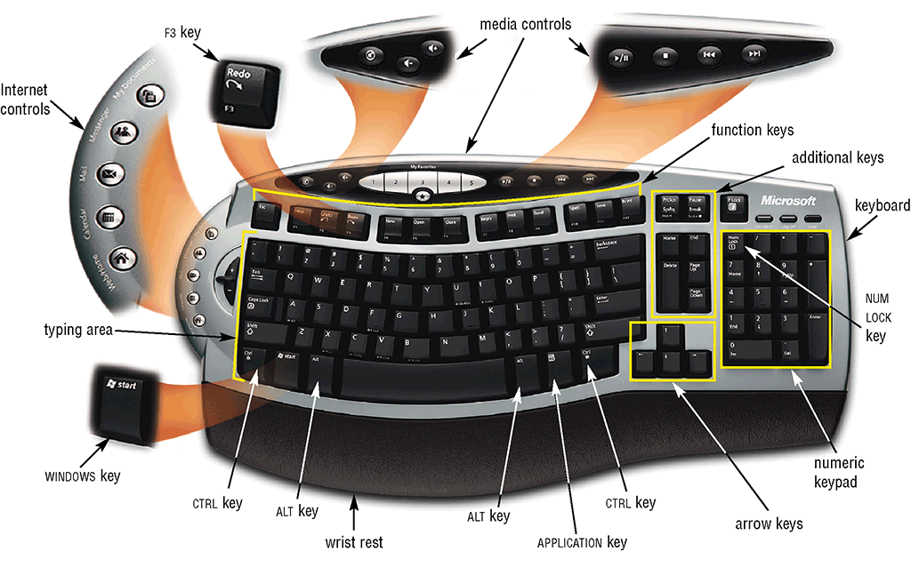
The Keyboard
How is the keyboard divided?
Typing area
Numeric keypad
Function keys, special keys that issue commands
p. 236 Fig. 5-2
Next

Slide 6
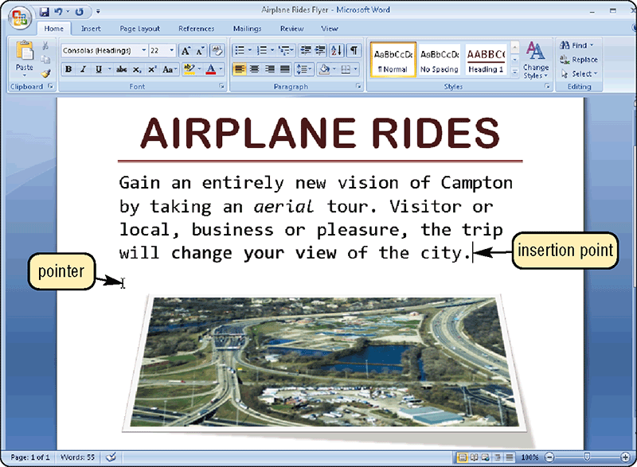
The Keyboard
What is the insertion point?
Blinking vertical bar that indicates where the next character you type will be displayed
p. 237 Fig. 5-3
Next

Slide 7
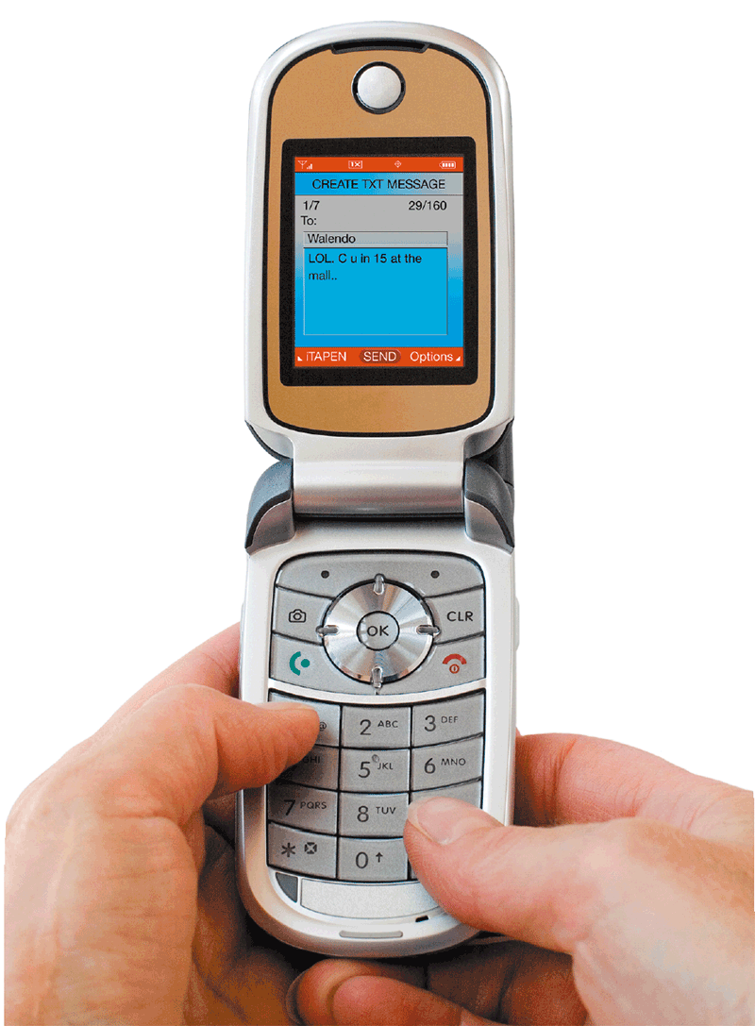
The Keyboard
How are keyboards attached?
Desktop computer keyboards often attach via a cable
Wireless keyboards communicate with a receiver attached to a port on the system unit
Keyboards often are built into mobile devices
p. 238 Fig. 5-4
Next

Slide 8
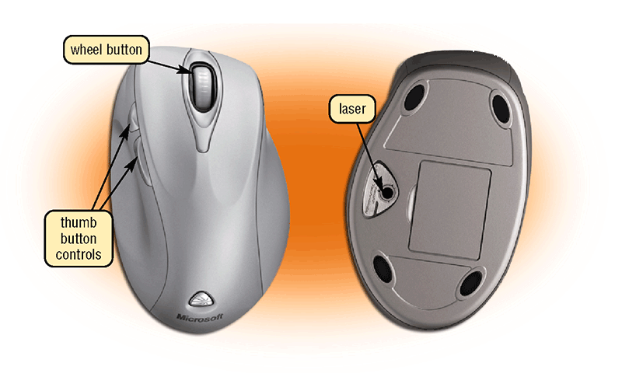
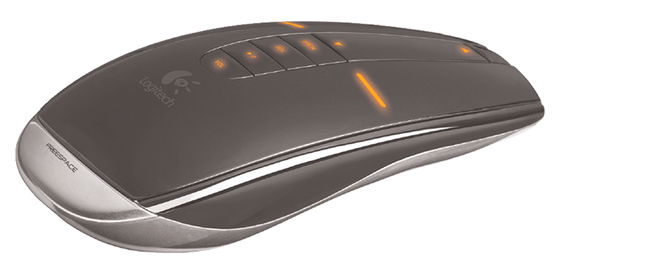
Pointing Devices
What is a mouse?
Pointing device that fits under palm of hand
Pointing device controls movement of pointer
Mechanical mouse
Optical mouse
Laser mouse
Air mouse
Wireless mouse
Click to view Web Link, click Chapter 5, Click Web Link from left navigation,
then click Air Mouse below Chapter 5
p. 239 Fig. 5-5 and 5-6
Next

Slide 9
Pointing Devices
What are common mouse operations?
Point
Click
Right- click
Double- click
Triple- click
Drag
Right- drag
Rotate wheel
Free- spin
wheel
Press wheel
button
Tilt wheel
p. 240 Fig. 5-7
Next

Slide 10
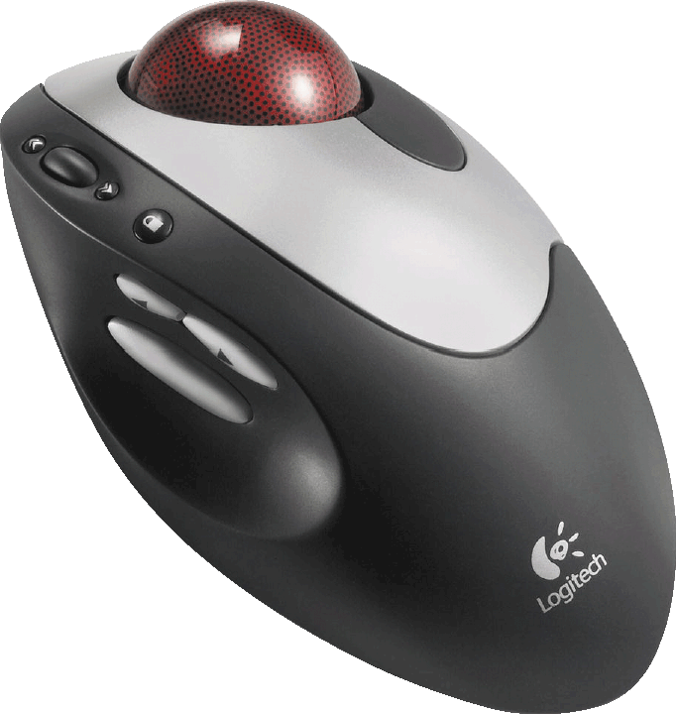
Other Pointing Devices
What is a trackball?
Stationary pointing device with a ball on its top or side
To move pointer, rotate ball with thumb, fingers, or palm of hand
Click to view Web Link, click Chapter 5, Click Web Link from left navigation,
then click Repetitive Strain Injuries below Chapter 5
p. 241 Fig. 5-8
Next

Slide 11
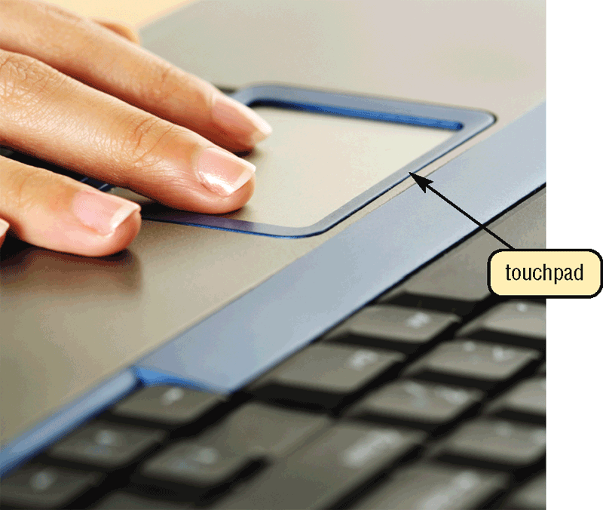
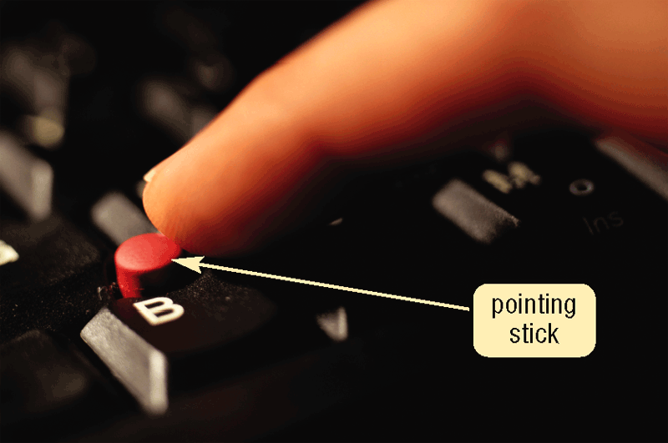
Other Pointing Devices
What are a touchpad and a pointing stick?
Touchpad is small, flat, rectangular pointing device sensitive to pressure and motion
Pointing stick is pointing device shaped like pencil eraser positioned between keys on keyboard
p. 241 - 242 Figs. 5-9—5-10
Next

Slide 12
Other Pointing Devices
What is a light pen?
Handheld input device that can detect light
Press light pen against screen surface and then press button on pen
p. 242
Next

Slide 13
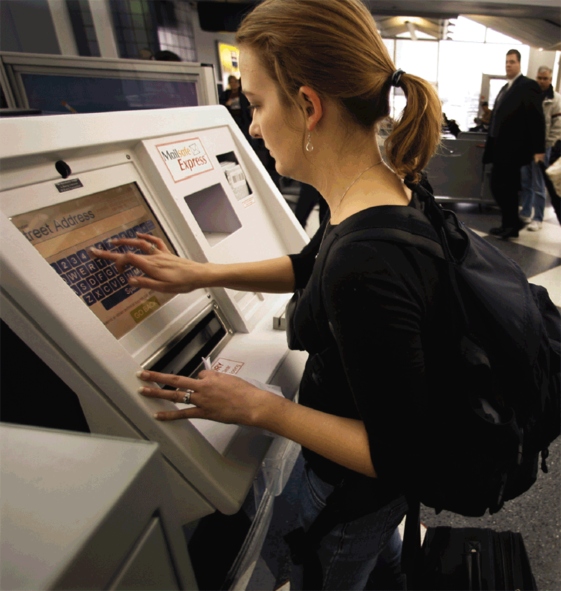
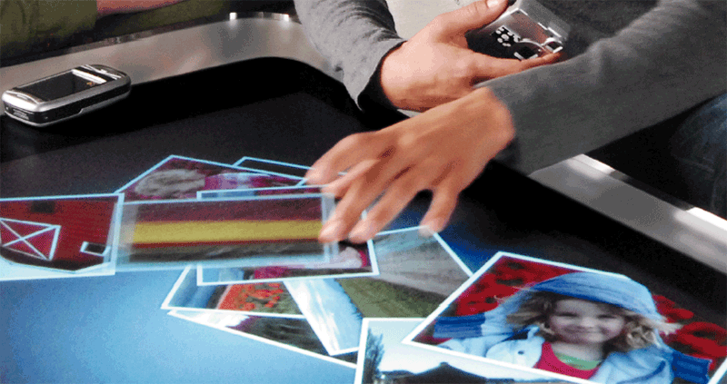
Other Pointing Devices
What is a touch screen?
Touch areas of screen with finger
Often used with kiosks
Microsoft Surface is a 30-inch tabletop display that allows one or more people to interact with the screen using their fingers or hands
Click to view Web Link, click Chapter 5, Click Web Link from left navigation,
then click Microsoft Surface below Chapter 5
p. 242 Fig. 5-12 and 5-13
Next

Slide 14
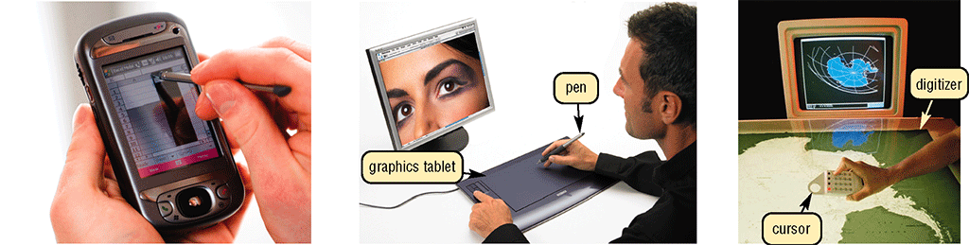
Keyboard and Pointing Devices
What is a digital pen?
Looks like a ballpoint pen, but uses pressure to write text and draw lines
Used with graphics tablets, flat electronic boards
Click to view Web Link, click Chapter 5, Click Web Link from left navigation,
then click Graphics Tablets below Chapter 5
p. 243 Fig. 5-14
Next

Slide 15
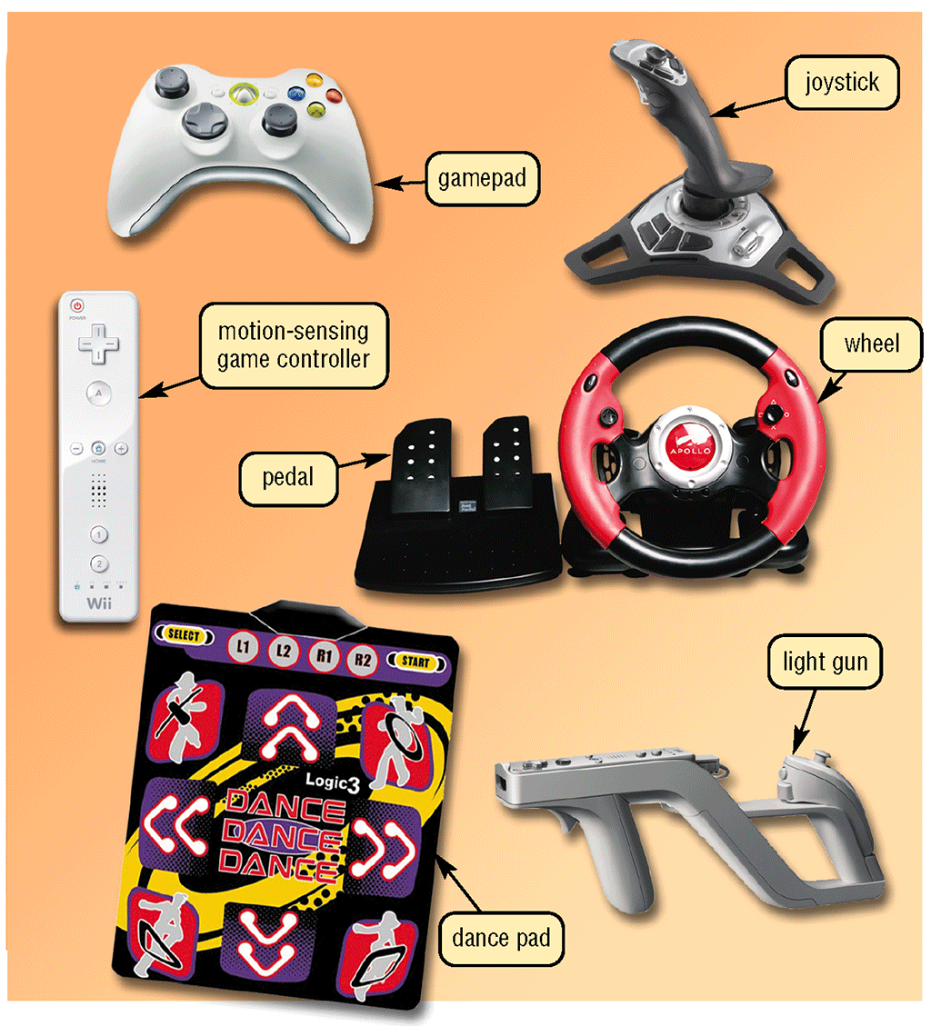
Controllers for Gaming and Media Players
What are the types of game controllers?
Gamepads
Joysticks and Wheels
Light gun
Dance pad
Motion-sensing game controller
Click to view Web Link, click Chapter 5, Click Web Link from left navigation,
then click Wii Remote below Chapter 5
p. 244 - 245 Fig. 5-15
Next

Slide 16
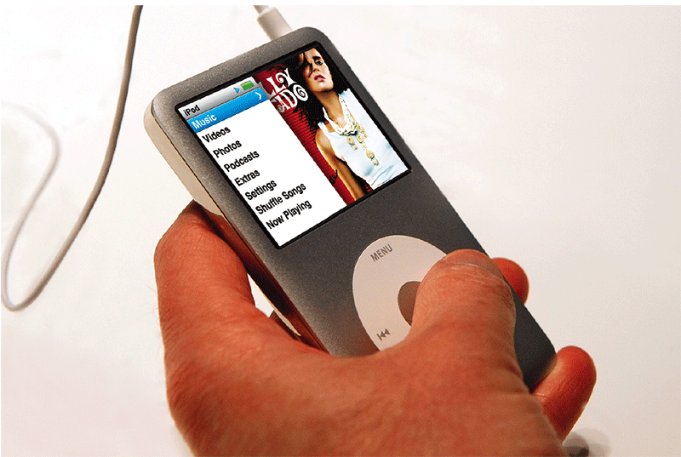
Controllers for Gaming and Media Players
What is a touch-sensitive pad?
Input device on a portable media player that enables users to scroll through and play music, view pictures, watch videos or movies, adjust volume, and customize settings
Click Wheel
p. 245 Fig. 5-16
Next

Slide 17

Voice Input
What is voice input?
The process of entering input by speaking into a microphone
Voice recognition is the computer’s capability of distinguishing spoken words
Click to view Web Link, click Chapter 5, Click Web Link from left navigation,
then click Voice Input below Chapter 5
p. 245 - 246 Fig. 5-17
Next

Slide 18
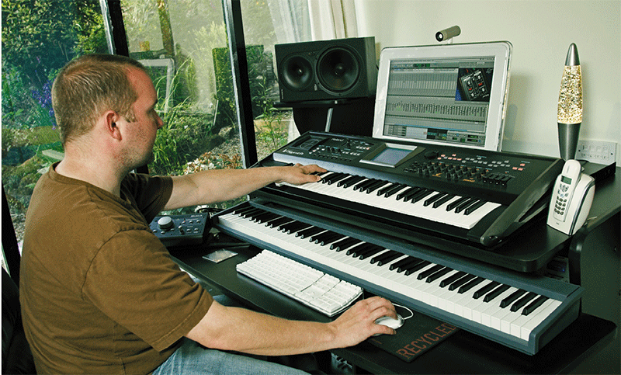
Voice Input
What is a MIDI (musical instrument digital interface)?
External device, such as electronic piano keyboard, to input music and sound effects
p. 246 Fig. 5-18
Next

Slide 19
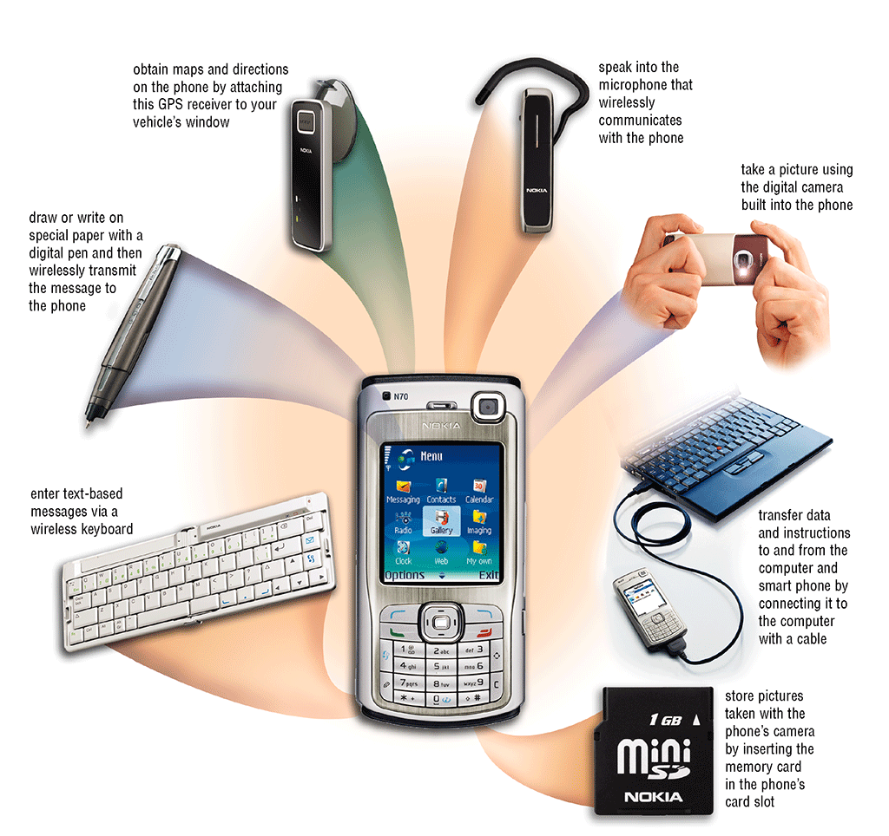
Input for Smart Phones, PDAs, and Tablet PCs
How is data entered into a smart phone?
Talk directly into the microphone, or by using digital cameras and touch-sensitive pads
p. 247 Fig. 5-19
Next

Slide 20
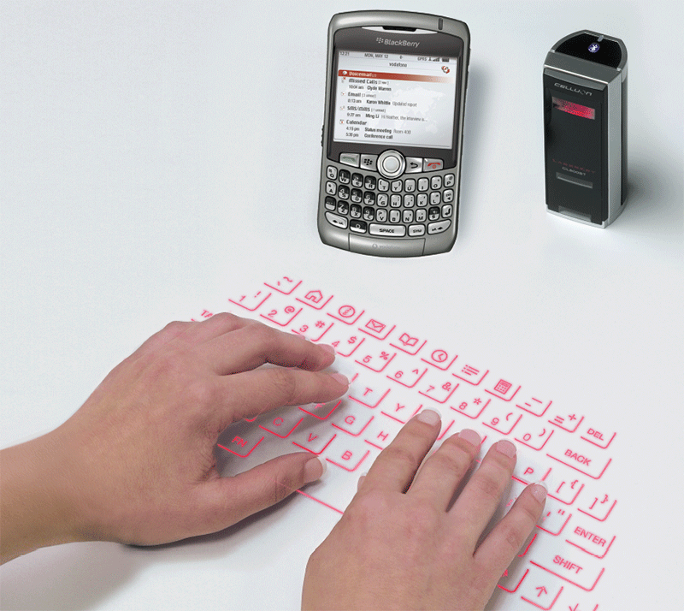
Input for Smart Phones, PDAs, and Tablet PCs
What is a portable keyboard?
A portable keyboard is a full-sized keyboard that communicates with the phone
p. 248 Fig. 5-20
Next

Slide 21

Input for Smart Phones, PDAs, and Tablet PCs
What is a smart phone?
Users can input and send text messages, graphics, pictures, video clips, and sound files
Many have a built-in or attachable camera
p. 248 - 249 Fig. 5-21
Next

Slide 22
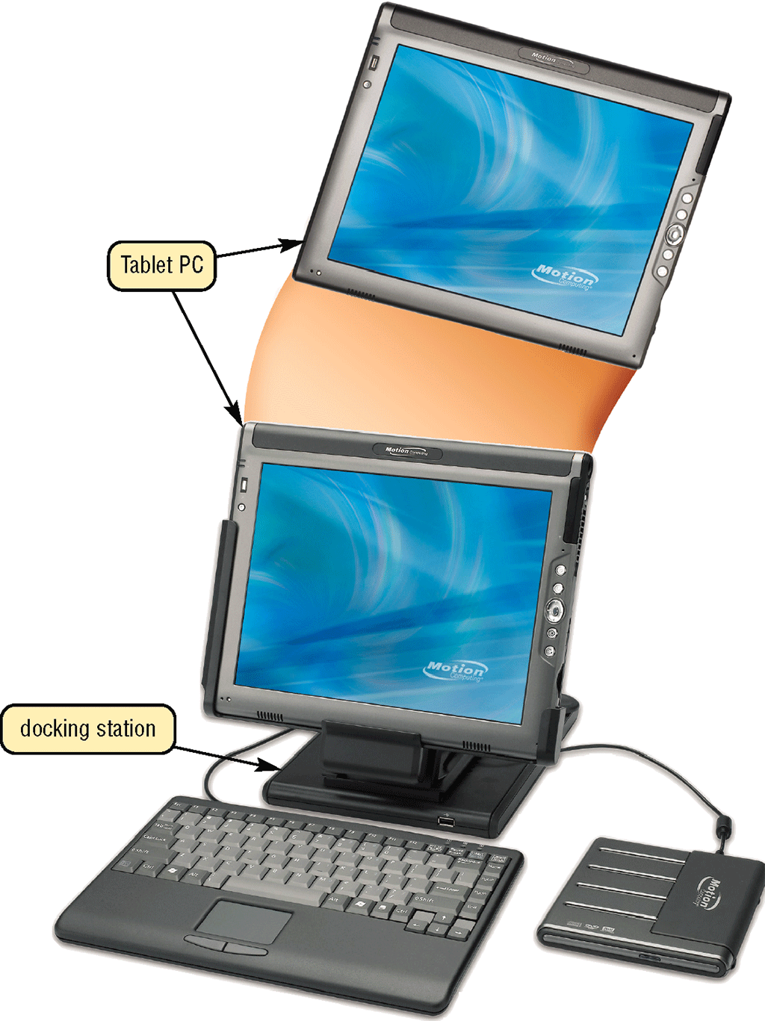
Input for Smart Phones, PDAs, and Tablet PCs
What is a Tablet PC?
Mobile computer that includes handwriting recognition software
Primary input device is a pressure-sensitive digital pen
p. 249 – 250 Fig. 5-23
Next

Slide 23
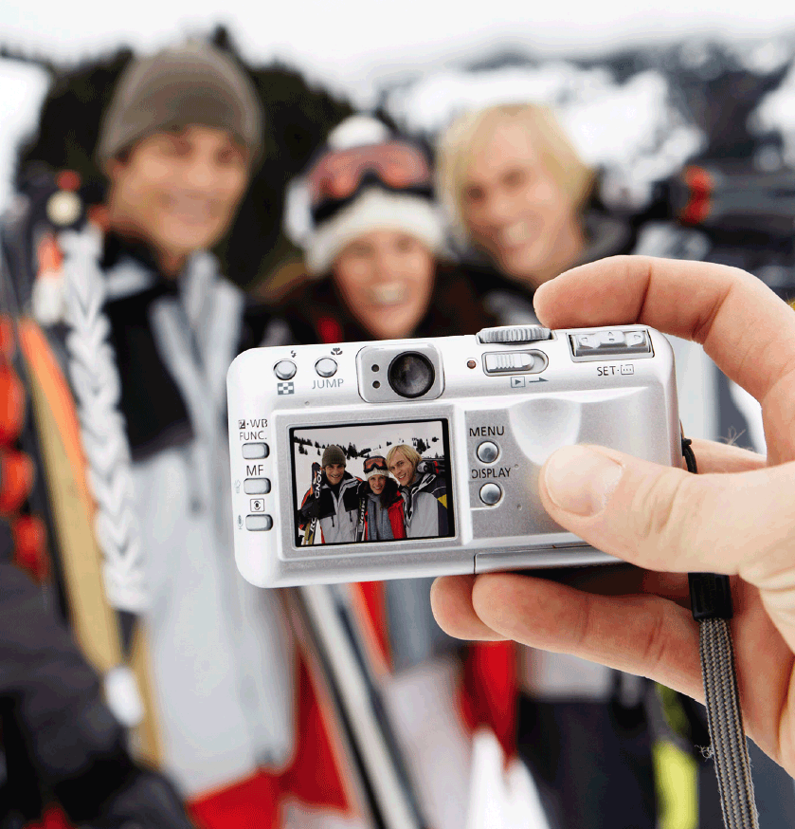
Digital Cameras
What is a digital camera?
Allows you to take digital pictures
Images viewable immediately on camera
Download to computer
Post pictures to Web
p. 250 - 251 Fig. 5-24
Next

Slide 24
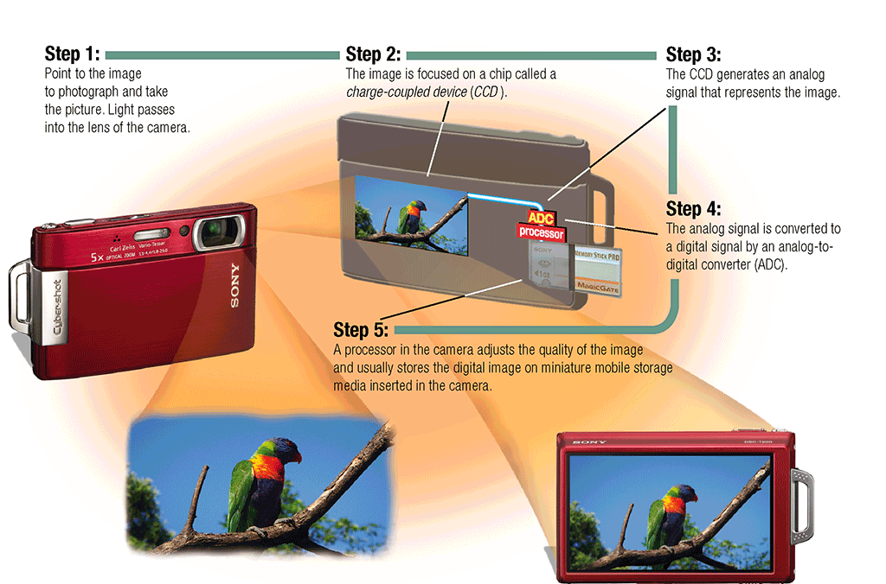
Digital Cameras
How does a digital camera work?
p. 251 Fig. 5-25
Next

Slide 25
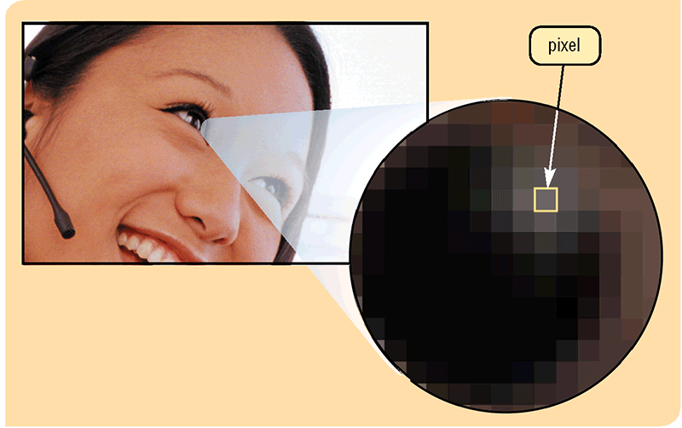
Digital Cameras
What is resolution?
Sharpness and clarity of image
The higher the resolution, the better the image quality, but the more expensive the camera
Pixel (picture element) is single point in electronic image
Greater the number of pixels, the better the image quality
p. 252 Fig. 5-26
Next

Slide 26
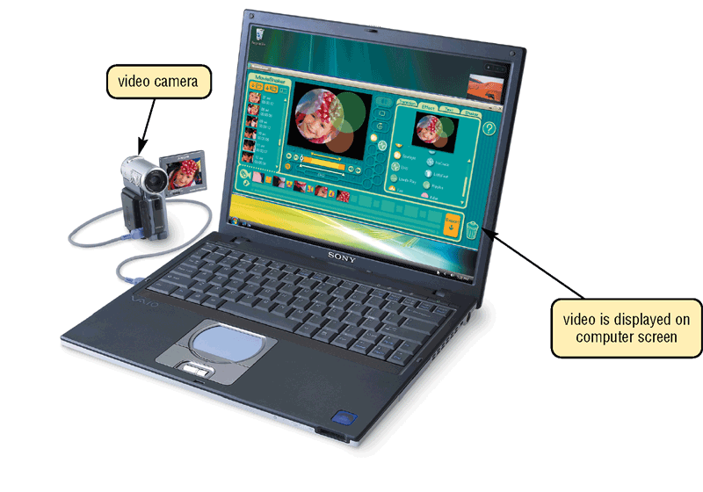
Video Input
What is video input?
Process of entering full-motion images into computer
Video capture card is adapter card that converts analog video signal into digital signal that computer can use
Digital video (DV) camera records video as digital signals
p. 253 Fig. 5-27
Next

Slide 27
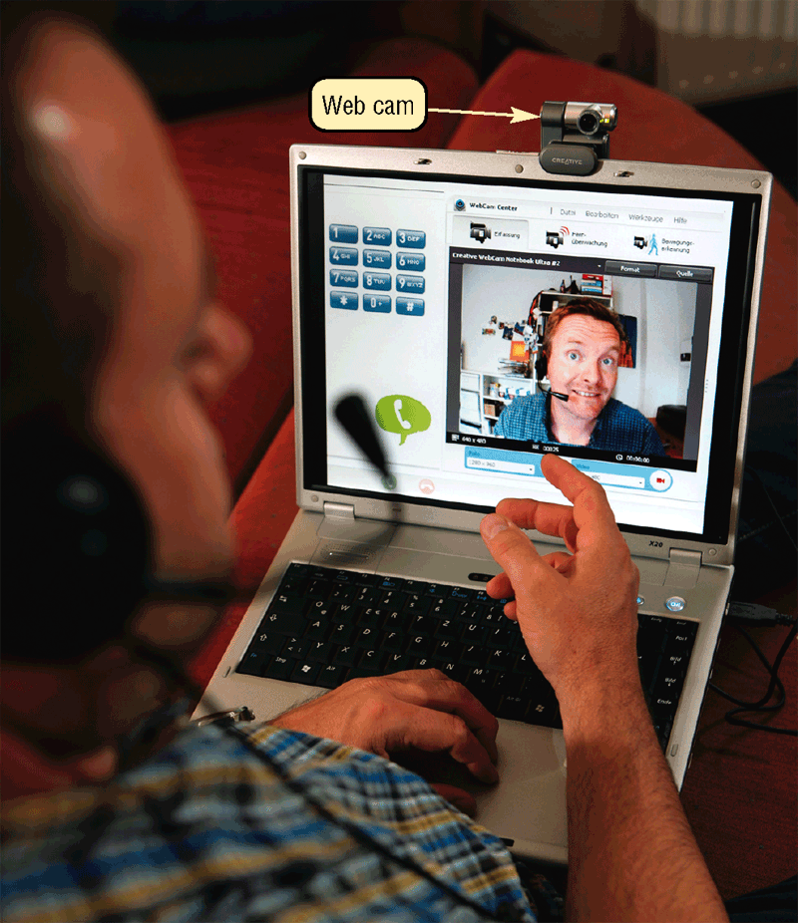
Video Input
What is a Web cam?
Web cam is used to capture video and still images, send e-mail messages with video attachments, add live images to instant messages, broadcast live images over the Internet, and to make video telephone calls on Internet
Click to view Web Link, click Chapter 5, Click Web Link from left navigation,
then click Web Cams below Chapter 5
p. 253 - 254 Fig. 5-28
Next

Slide 28
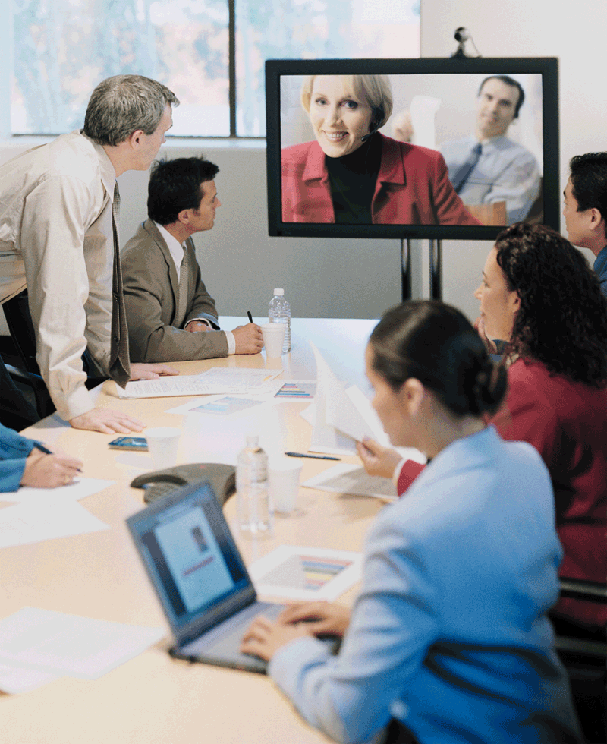
Video Input
What is video conferencing?
Two or more geographically separated people who use network or Internet to transmit audio and video data
Whiteboard is another window on screen that can display notes and drawings simultaneously on all participants’ screens
p. 254 Fig. 5-29
Next

Slide 29

Video Input
Video: Video Editing on Your Computer
CLICK TO START
Next

Slide 30
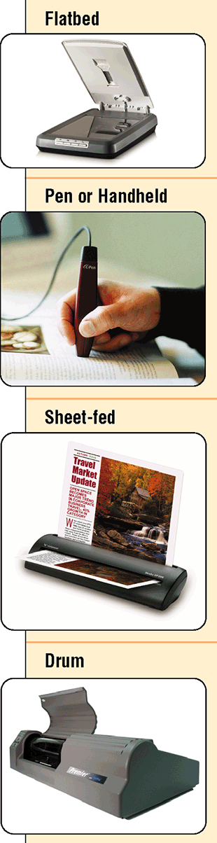
Scanners and Reading Devices
What is a scanner?
Light-sensing device that reads printed text and graphics
Used for image processing, converting paper documents into electronic images
p. 255 – 256 Fig. 5-30
Next

Slide 31
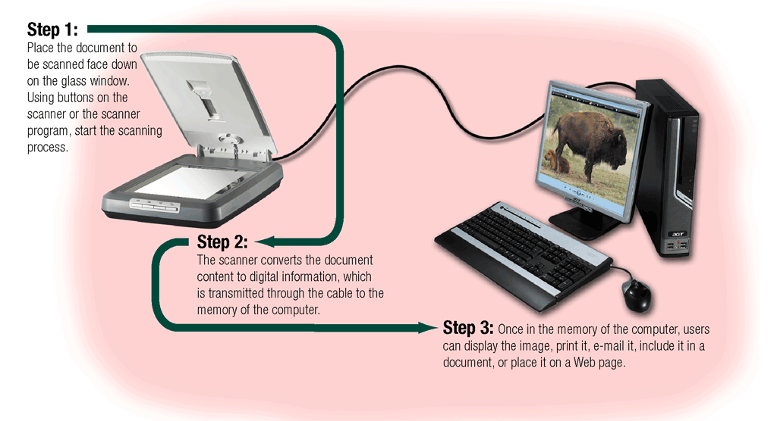
Scanners and Reading Devices
How does a flatbed scanner work?
p. 256 Fig. 5-31
Next

Slide 32
Scanners and Reading Devices
What is an optical reader?
Device that uses light source to read characters, marks, and codes and then converts them into digital data
Optical character recognition (OCR) reads characters in OCR font
Optical mark recognition (OMR) reads hand-drawn pencil marks, such as small circles
p. 257 Fig. 5-32
Next

Slide 33
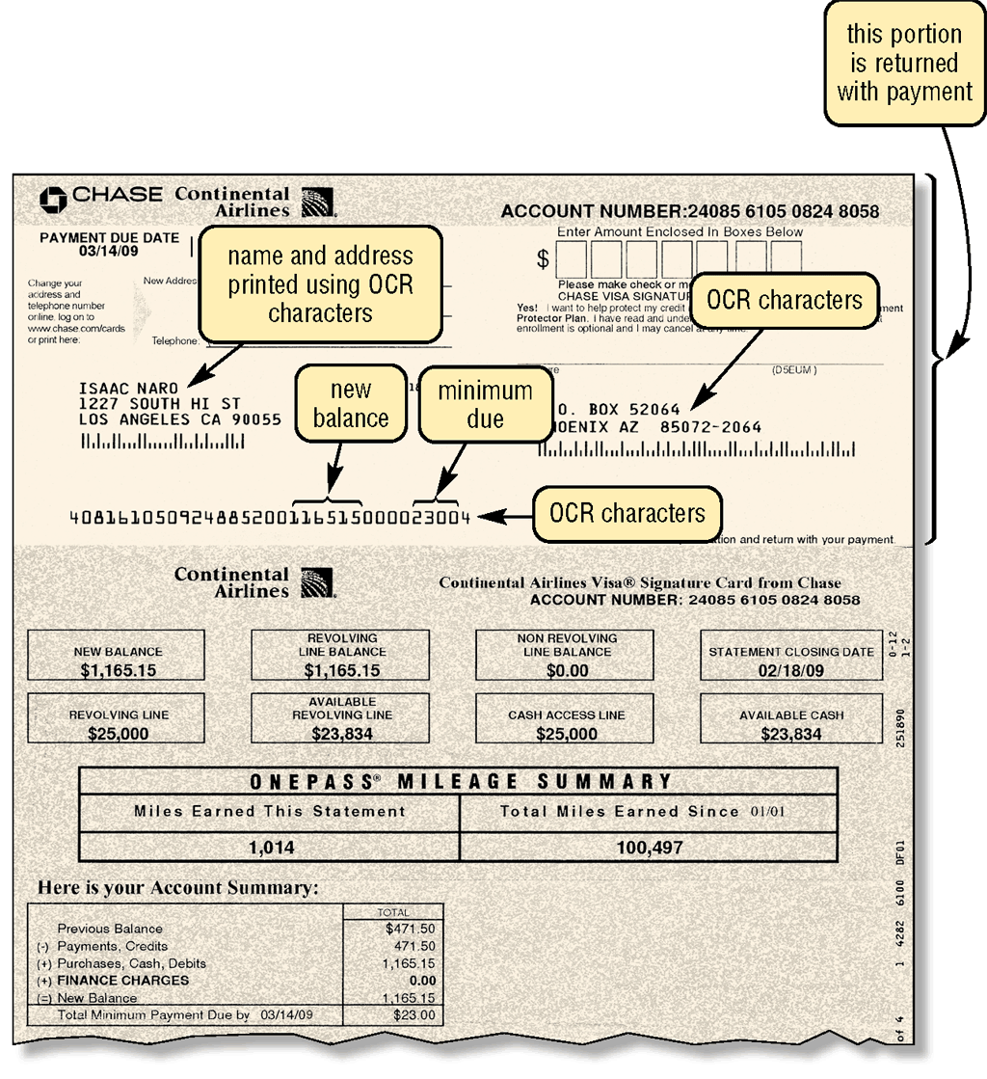
Scanners and Reading Devices
What is a turnaround document?
Document that you return to the company that sent it
Portion you return has information printed in OCR characters
p. 257 Fig. 5-33
Next

Slide 34
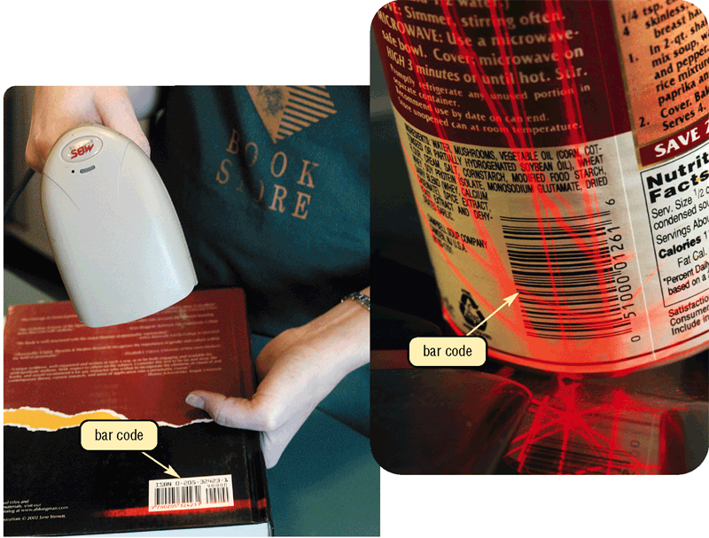
Scanners and Reading Devices
What is a bar code reader?
Uses laser beams to read bar codes
Click to view Web Link, click Chapter 5, Click Web Link from left navigation,
then click Bar Code Readers below Chapter 5
p. 258 Fig. 5-35
Next

Slide 35
Scanners and Reading Devices
What is a bar code?
Identification code that consists of a set of vertical lines and spaces of different widths
POSTNET
Universal Product Code (UPC)
p. 258 Fig. 5-35
Next

Slide 36
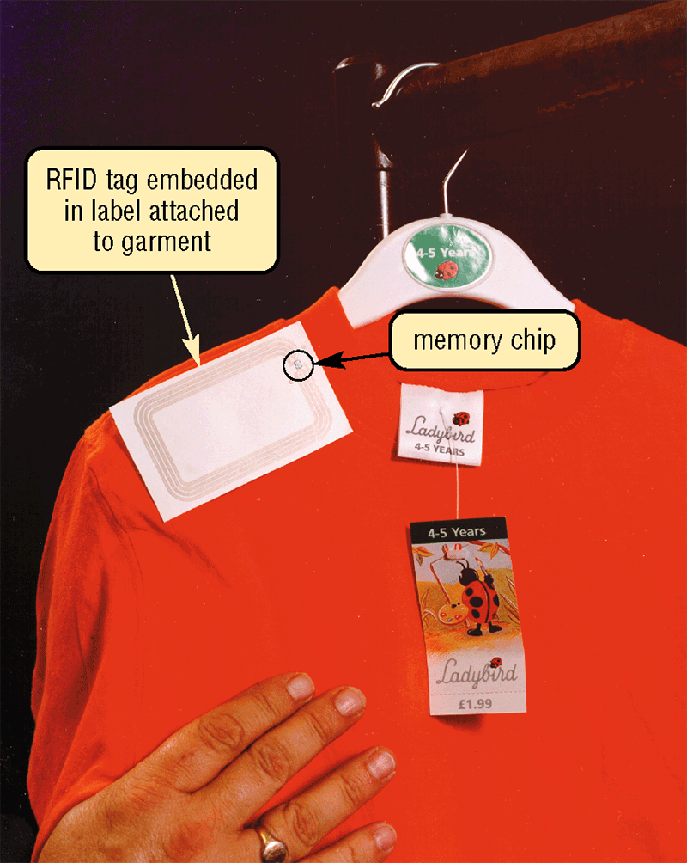
Other Input Devices
What is an RFID reader?
Reads information on the tag via radio waves
Can be handheld devices or mounted in a stationary object
p. 259 Fig. 5-36
Next

Slide 37
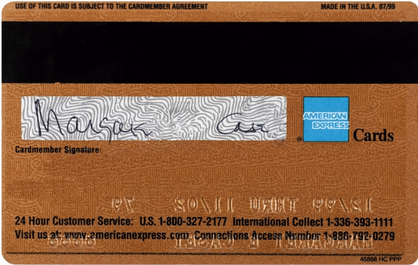
Other Input Devices
What is a magnetic stripe card reader?
Reads the magnetic stripe on the back of a credit card
Exposure to a magnetic field can erase the contents of a card’s magnetic stripe
p. 260 Fig. 5-37
Next

Slide 38
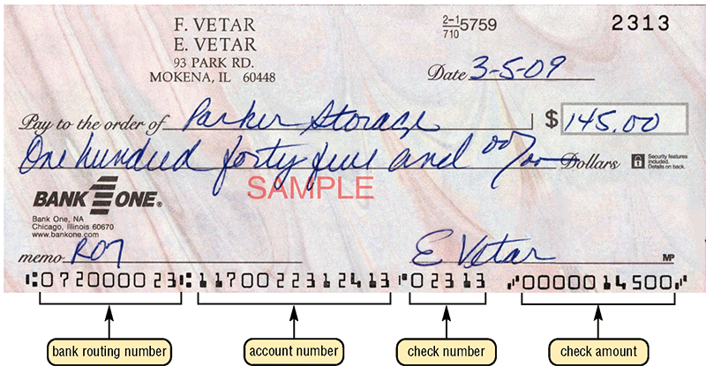
Scanners and Reading Devices
What is a magnetic-ink character recognition (MICR) reader?
Can read text printed with magnetized ink
Banking industry almost exclusively uses MICR for check processing
p. 260 Fig. 5-38
Next

Slide 39
Scanners and Reading Devices
What is a data collection device?
Obtains data directly at location where transaction or event takes place
Transmits data over network or Internet
p. 261 Fig. 5-39
Next

Slide 40
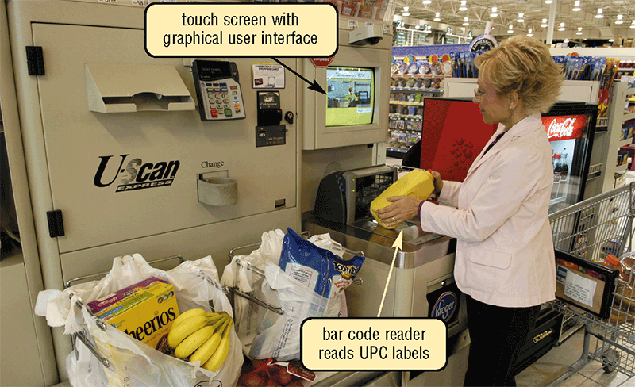
Terminals
What is a point of sale (POS) terminal?
Records purchases, processes credit or debit cards, and updates inventory
Swipe credit or debit card through card reader or use your fingerprint
Reads customer’s personal data from magnetic strip
p. 261 - 262 Fig. 5-40
Next

Slide 41
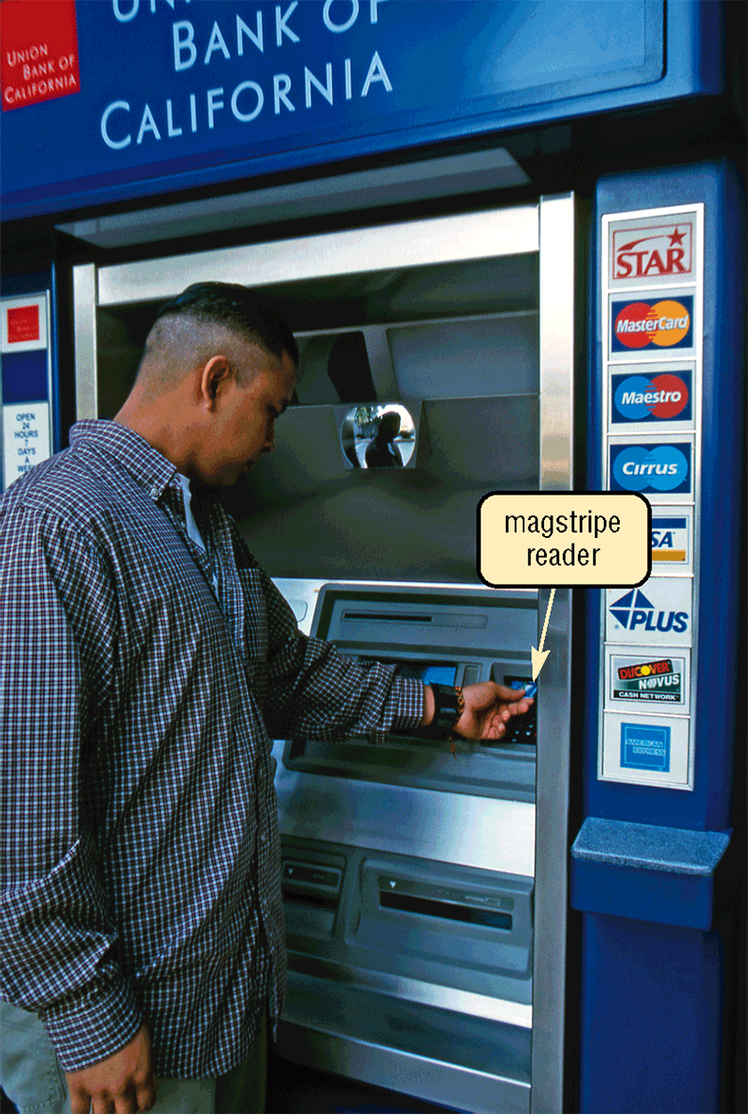
Terminals
What is an automated teller machine (ATM)?
Self-service banking machine that connects to a host computer through a network
p. 262 Fig. 5-41
Next

Slide 42
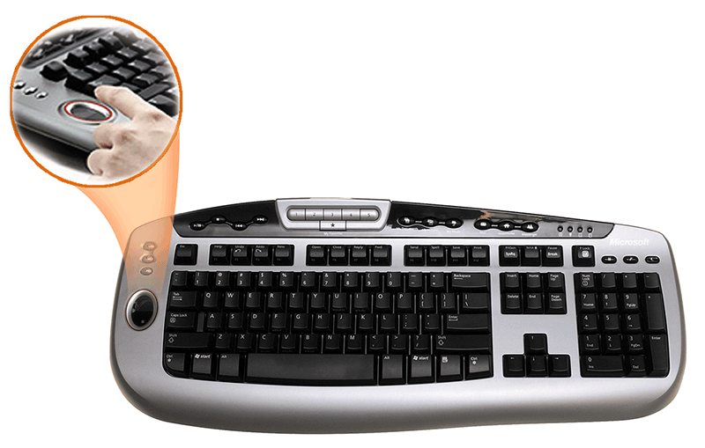
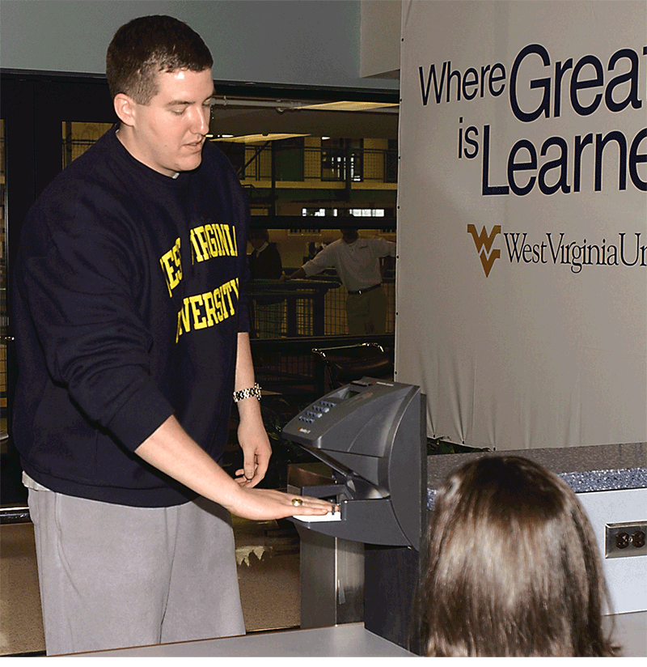
Biometric Input
What is biometrics?
Authenticates person’s identity by verifying personal characteristic
Fingerprint reader captures curves and indentations of fingerprint
Hand geometry system measures shape and size of person’s hand
Click to view Web Link, click Chapter 5, Click Web Link from left navigation,
then click Biometric Input below Chapter 5
p. 262 – 264 Fig. 5-42 and 5-43
Next

Slide 43
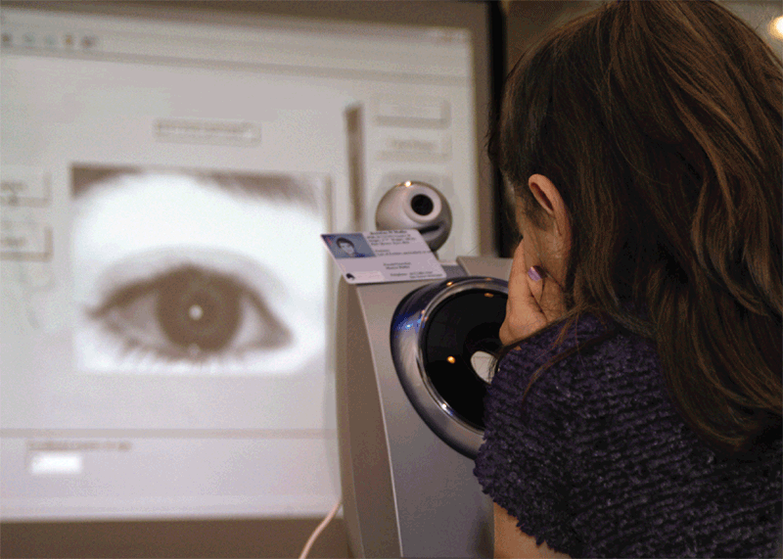
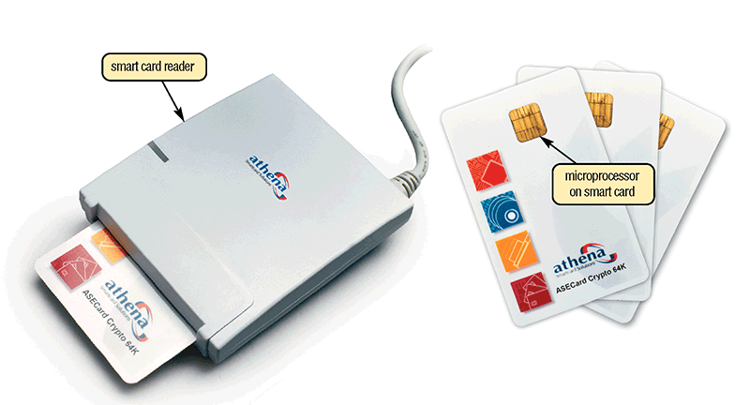
Biometric Input
What are examples of biometric technology?
Voice verification system compares live speech with stored voice pattern
Signature verification system recognizes shape of signature
Iris recognition system reads patterns in blood vessels in back of retina
Biometric data is sometimes stored on smart card, which stores personal data on microprocessor embedded in card
p. 263 – 264 Figs. 5-44—5-45
Next

Slide 44

Putting It All Together
What are recommended input devices for home users?
Enhanced keyboard or ergonomic keyboard
Mouse
Stylus for smart phone or other personal mobile device
Game controller(s)
30-bit 600 x 1200 ppi color scanner
4-megapixel digital camera
Headphones that include a microphone (headset)
Web cam
Fingerprint reader
p. 265 Fig. 5-46
Next

Slide 45

Putting It All Together
What are recommended input devices for small office/home office users (SOHO)?
Enhanced keyboard or ergonomic keyboard
Mouse
Stylus and portable keyboard for smart phone or other personal mobile device, or digital pen for Tablet PC
36-bit 600 x 1200 ppi color scanner
5-megapixel digital camera
Headphones that include a microphone (headset)
Web cam
p. 265 Fig. 5-46
Next

Slide 46
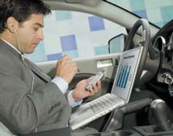
Putting It All Together
What are recommended input devices for mobile users?
Wireless mouse for notebook computer
Touchpad or pointing stick on notebook computer
Stylus and portable keyboard for smart phone or other personal mobile device, or digital pen for Tablet PC
4- or 5-megapixel digital camera
Headphones that include a microphone (headset)
Fingerprint reader for notebook computer
p. 265 Fig. 5-46
Next

Slide 47
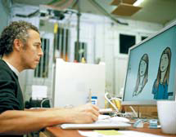
Putting It All Together
What are recommended input devices for power users?
Enhanced keyboard or ergonomic keyboard
Mouse
Stylus and portable keyboard for smart phone or personal mobile device
Pen for graphics tablet
48-bit 1200 x 1200 ppi color scanner
6- to 12-megapixel digital camera
Headphones that include a microphone (headset)
Web cam
p. 265 Fig. 5-46
Next

Slide 48
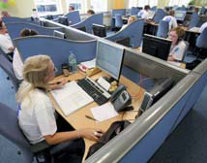
Putting It All Together
What are recommended input devices for large business users?
Enhanced keyboard or ergonomic keyboard
Mouse
Stylus and portable keyboard for smart phone or other personal mobile device, or digital pen for Tablet PC
Touch screen
Light pen
42-bit 1200 x 1200 ppi color scanner
6- to 12-megapixel digital camera
OCR/OMR readers, bar code readers, MICR reader, or data collection devices
Microphone
Video camera for video conferences
Fingerprint scanner or other biometric device
p. 265 Fig. 5-46
Next

Slide 49
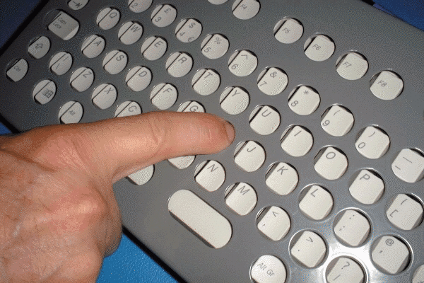
Input Devices for Physically Challenged Users
What input devices are available for those with physical limitations?
Keyguard allows users to rest hands on keyboard without accidentally pressing keys
Head-mounted pointer controls pointer on screen
New developments include gesture recognition and computerized implant devices
p. 266 Figs. 5-47
Next

Slide 50
Summary of Input
Keyboard, mouse, and other pointing devices; controllers for gaming and media players
Scanners and reading devices
Voice input
Terminals
Input devices for smart phones, PDAs, and Tablet PCs
Biometric input
Digital cameras
Input devices for physically challenged users
Video Input
Chapter 5 Complete

